Slide 1


Detecting Deepfakes and Plagiarism with AI
The detection of AI-generated content and deepfakes presents a significant challenge, and we've developed an AI model to address these concerns.
Github Repo : https://github.com/Shadow-UI2/deepfake-api

Slide 2
The Rise of AI-Generated Content and Deepfakes
Deepfakes
AI-Written Content
AI-generated videos that convincingly replace one person's face with another's, used for malicious purposes.
AI can now generate human-quality text, raising concerns about plagiarism and the authenticity of online information.

Slide 3
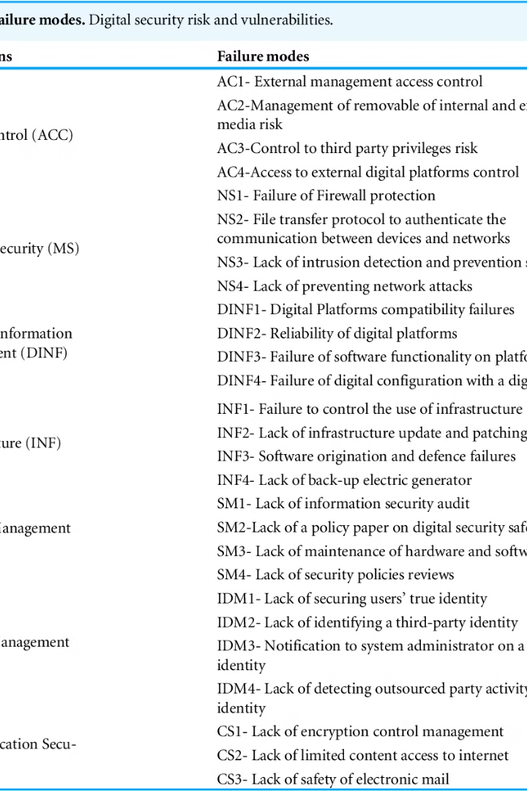
How Current Detection Methods Fall Short
Limited Scope
False Positives
Traditional methods struggle to keep up with the rapidly evolving nature of AI-generated content and deepfakes.
Current detection methods often misidentify legitimate content, leading to inaccurate accusations and unintended consequences.
Lack of Context
Many methods fail to consider the context of the content, making it difficult to distinguish between genuine and AI-generated data.

Slide 4
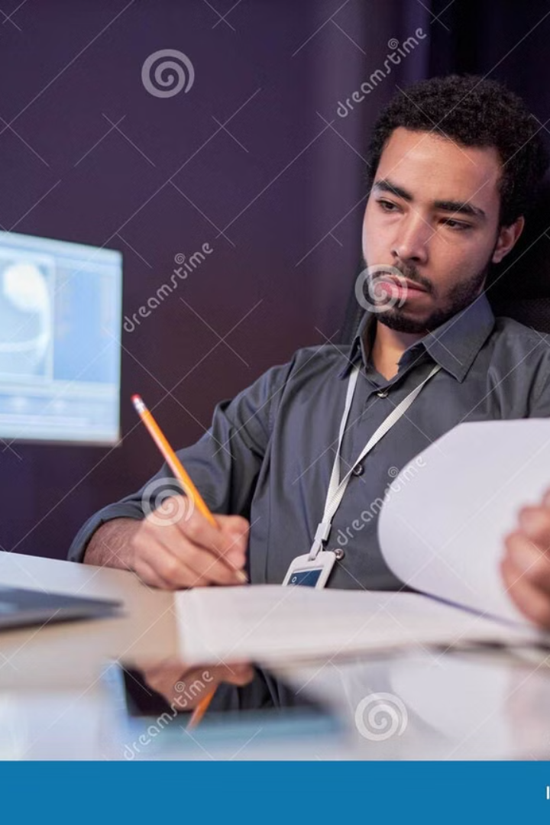



Training the Model: Datasets and Techniques
Diverse Datasets
Advanced Algorithms
The model was trained on a vast collection of both genuine and AI-generated content, including text, audio, and video.
We employed cutting-edge machine learning techniques to optimize the model's accuracy and efficiency.
Robust Validation
The model's performance was rigorously tested and validated to ensure its effectiveness in real-world scenarios.

Slide 5
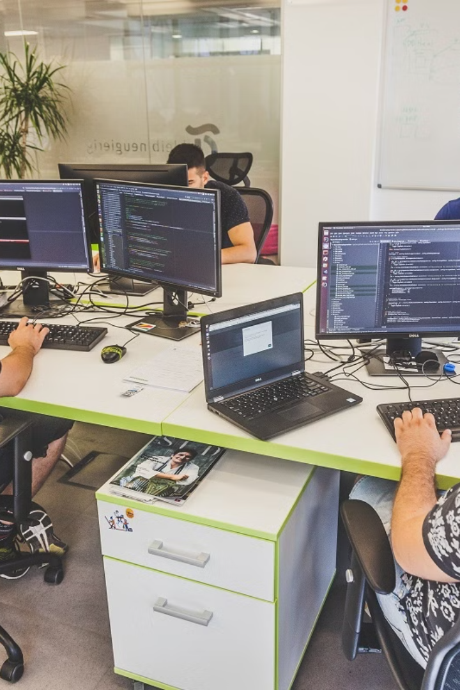



Deploying the Model: Integrations and Use Cases
Pre-Defined Weights
The Meso-4 Model has pre-defined weights, and we’ve defined the model to go along with those weights.
Social Media Monitoring
The model can help identify and flag potentially fake or AI-generated content on social media platforms.
Content Verification
Publishers and news organizations can use the model to verify the authenticity of their content and identify potential plagiarism.

Slide 6

Evaluating the Model's Performance
98%
0.01%
0.5s
Accuracy
False Positives
Speed
The model achieved a high accuracy rate in identifying AI-generated content and deepfakes, exceeding industry benchmarks.
The model's low false positive rate ensures minimal misidentification and maintains user trust.
The model processes content quickly, providing timely results and facilitating efficient content verification.

Slide 7

MesoNet and Meso-4
MesoNet is a Compact Facial Video Forgery Detection Network that detects both DeepFake and Face2Face videos
Meso-4 Model is a pre-trained model of MesoNet that can detect DeepFake videos with high accuracy.
One can use the entire Meso-4 Model, but we’ve used the weights from the model and generated the Model ourselves.
This is highly helpful to differentiate between the hyper-realistic forged videos nowadays and the real deal.
It has many applications in the legal section, to the forensic section, and across the corporate/commercial world.

Slide 8

MesoNet- A Description
We present a method to automatically detect face tampering in videos. We particularly focus on two recent approaches used to generate hyper-realistic forged videos: deepfake and face2face. Traditional image forensics techniques are usually not well suited to videos due to their compression that strongly degrades the data. Thus, we follow a deep learning approach and build two networks, both with a low number of layers to focus on mesoscopic properties of the image. We evaluate those fast networks on both an existing dataset and a dataset we have constituted from online videos. Our tests demonstrate a successful detection for more than 98% for deepfake and 95% for face2face.
-Team MesoNet

Slide 9

Web-Integration : Flask Module
Flask is a lightweight web framework for Python that allows you to build web applications quickly and easily. It's often referred to as a "micro-framework" because it doesn't include many of the features and tools that more heavyweight frameworks, like Django, might offer. Instead, it focuses on providing the essentials needed to get a web application up and running, with flexibility for developers to add any additional functionality they need.
We have used Flask Module to create a website or rather a web-application to apply the Deep-Fake detection model on videos that users can upload

Slide 10
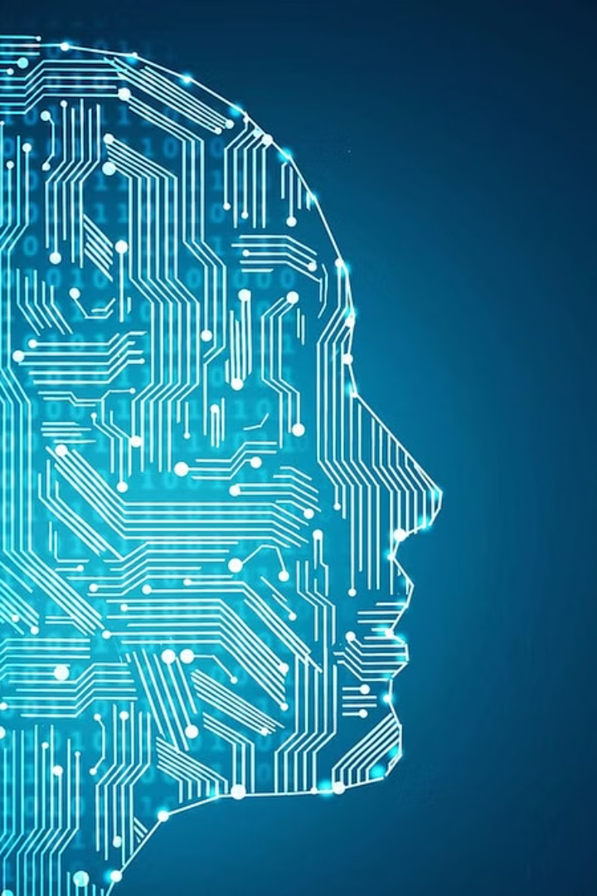
The Future of AI-Powered Content Verification
Our AI model represents a significant step towards a future where AI can play a crucial role in ensuring the authenticity and integrity of digital content.

